Slide 1

Workshops
Week 1 –Introduction
Danai Korre

Slide 2

Python

Slide 3
What is Python?
Python is an interpreted, object-oriented, high-level programming language with dynamic semantics. Its high-level built in data structures, combined with dynamic typing and dynamic binding, make it very attractive for Rapid Application Development, as well as for use as a scripting or glue language to connect existing components together. Python's simple, easy to learn syntax emphasizes readability and therefore reduces the cost of program maintenance. Python supports modules and packages, which encourages program modularity and code reuse. The Python interpreter and the extensive standard library are available in source or binary form without charge for all major platforms, and can be freely distributed [1].

Slide 4
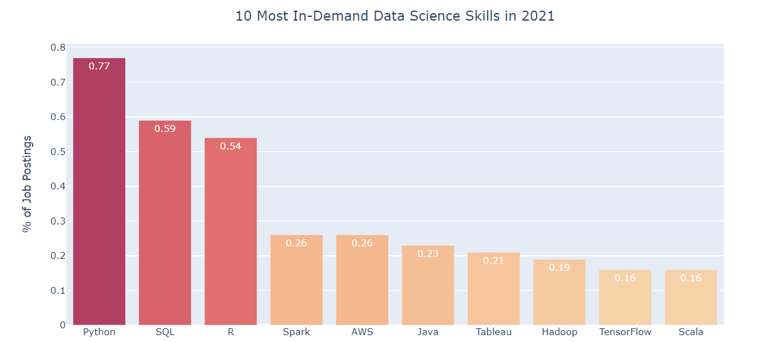
The Most In-Demand Skills for Data Scientists in 2021 Results from webscraping over 15,000 Data Scientist job postings
Source: towardsdatascience.com

Slide 5
Top Skills for Data Scientists in 2022
According to the Artificial Intelligence Report the top skills for data scientists in 2022 are:
Data Wrangling / Data Carpentry/ Feature Engineering
Writing SQL Queries & Building Data Pipelines
Storytelling (i.e. Communication) to complement Data visualization
Regression/Classification

Slide 6
Why Python?
It is free and open-source software.
It is well-documented and runs on all platforms.
It has a large and constantly growing user-base which includes scientists.
It is easier for novices to pick up than most other languages.

Slide 7
Why Python for Data Analysis?
Python has developed a large and active scientific computing and data analysis community. In the last 10 years, Python has become one of the most important languages for data science, machine learning, and general software development in academia and industry. In recent years, Python’s improved support for libraries (such as pandas and scikit-learn) has made it a popular choice for data analysis tasks. Combined with Python’s overall strength for general-purpose software engineering, it is an excellent option as a primary language for building data applications [2].

Slide 8
anaconda

Slide 9

What is Anaconda?
Anaconda is a distribution of the Python and R programming languages for scientific computing (data science, machine learning applications, large-scale data processing, predictive analytics, etc.), that aims to simplify package management and deployment. The distribution includes data-science packages suitable for Windows, Linux, and macOS [3].

Slide 10
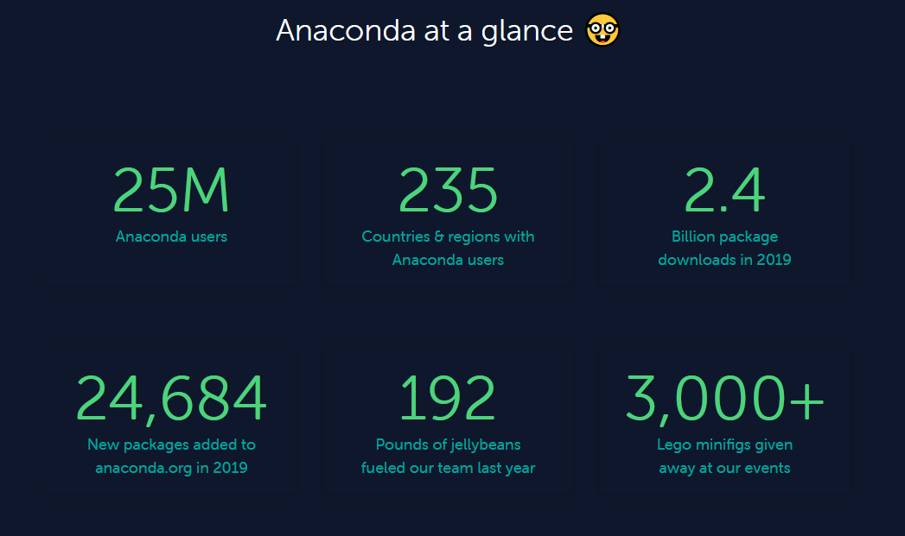

Slide 11
Jupyter notebook

Slide 12
What is the jupyter notebook app?
The Jupyter Notebook App is a server-client application that allows editing and running notebook documents via a web browser. The Jupyter Notebook App can be executed on a local desktop requiring no internet access (as described in this document) or can be installed on a remote server and accessed through the internet [4].

Slide 13
What is noteable?
The Noteable service is a cloud-based application providing access to Jupyter notebooks online. Noteable provides a central storage space to store and run Jupyter notebooks in a variety of languages.
The purpose of Noteable is to allow students and staff to access Jupyter notebooks at any time without the need for pre-installation which can be cumbersome and difficult for programming novices. Noteable is integrated with Learn to allow for a central launch point into a pre-set environment without the need for a separate login. Find more: https://www.ed.ac.uk/information-services/learning-technology/noteable/about

Slide 14
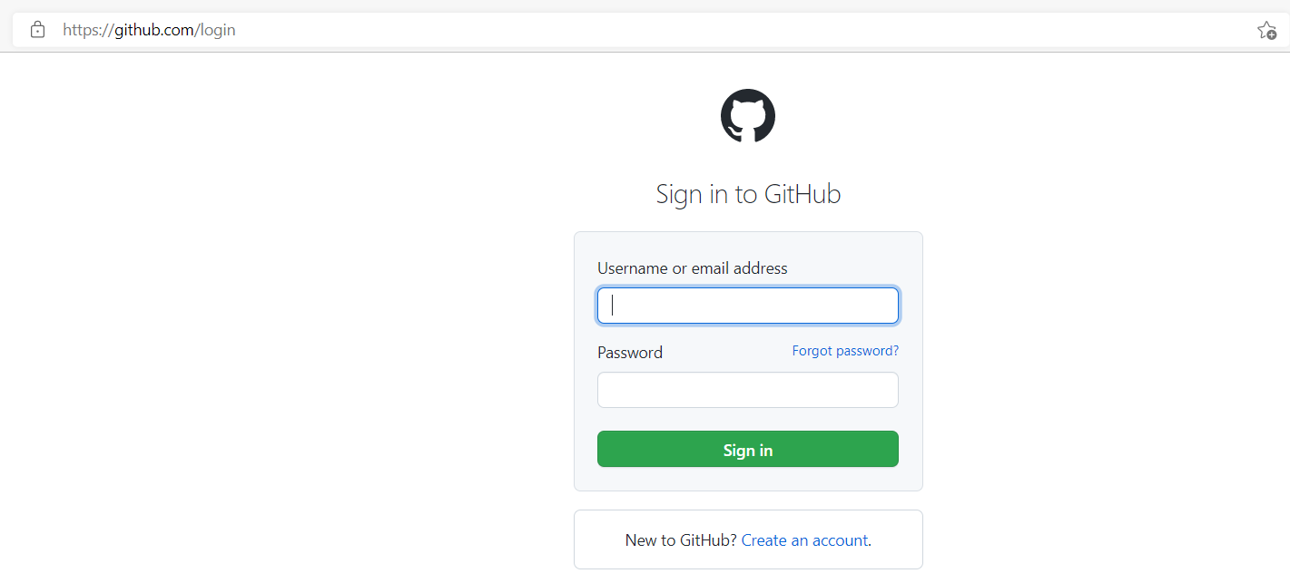
Set up
Step 1: Log in to your github account. If you don’t have an account, please go to https://github.com/ and sign up for a free account. It will be best if you used your personal email so you retain access to the material independent of your University account.

Slide 15
Set up
Step 2: Log in to servers (https://) using your University of Edinburgh student credentials.

Slide 16
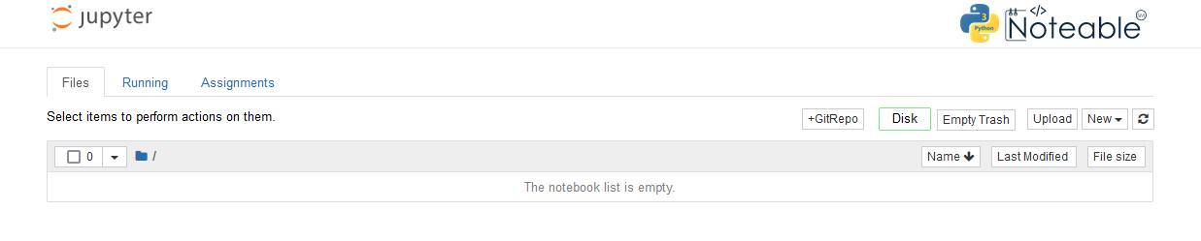
Set up
Step 2: Log in to Noteable (https://noteable.edina.ac.uk/launch) using your University of Edinburgh student credentials.

Slide 17
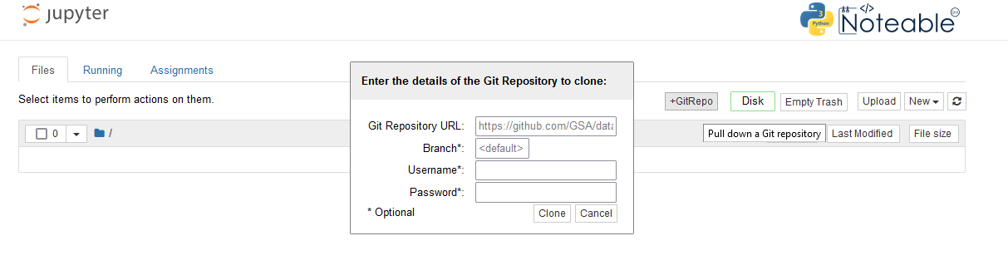
Set up
Step 3: Click on the +GitRepo icon as shown bellow and add the github repository with the Jupyter Notebooks and data files necessary for the workshops.

Slide 18
Set up
Step 4:
Git Repository URL:
Branch: as is
Username: as is (your github username when repo is private)
Password: as is (your github password when repo is private)

Slide 19
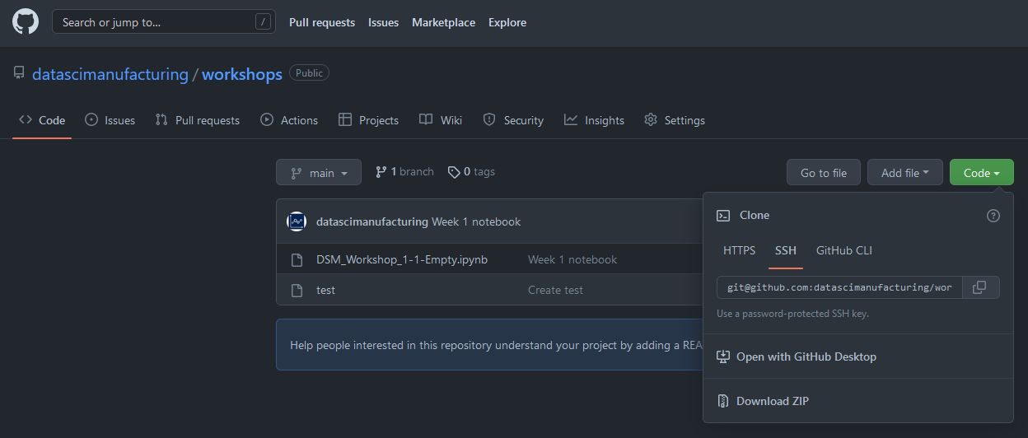
Set up
You can get the repository URL by clicking on the Code button on the github repository

Slide 20
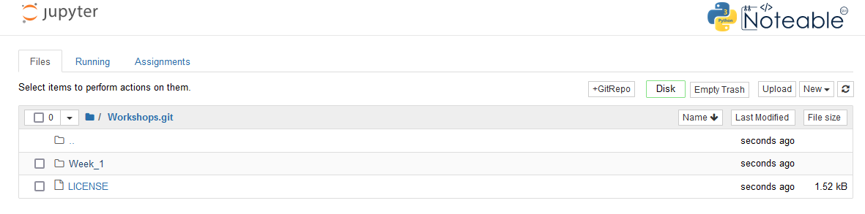
Set up
Step 5: Your Noteable page should look like this

Slide 21
Data: types and formats

Slide 22
Types of data
Quantitative: numerical
Qualitative: text

Slide 23
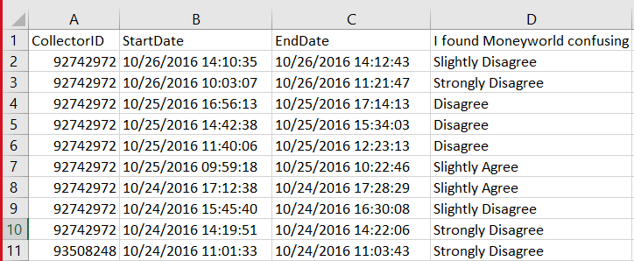
Quantitative
Annual sales
Profitability

Slide 24
Qualitative
Customer reviews
Explicit description of a malfunction in evaluation reports

Slide 25
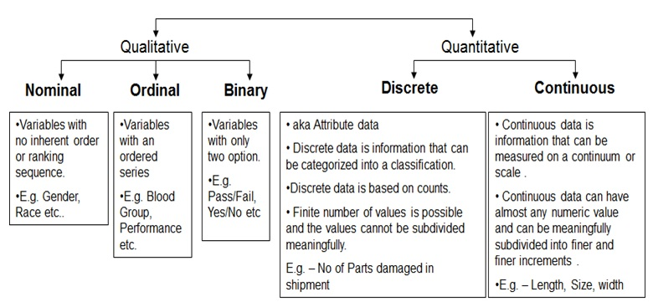
Types of data
Source: Six Sigma Institute

Slide 26
Structured data
Tabular or spreadsheet-like data in which each column may be a different type (string, numeric, date, or otherwise). This includes most kinds of data commonly stored in relational databases or tab- or comma-delimited text files.
Multidimensional arrays (matrices).
Multiple tables of data interrelated by key columns (what would be primary or foreign keys for a SQL user).
Evenly or unevenly spaced time series [1].

Slide 27
Tabular and csv
Tabular formats (ex. Excel)
Comma-delimited text files, CSV format

Slide 28
Tabular data
Columns (Fields)
Row (item)
Values stored to cells

Slide 29
Tabular data

Slide 30
CSV format
CSV stands for Comma Separated Values
Saves tabular information into a delimited text file with the series of values separated by commas
It is lightweight and consumes less memory
Each line of text is a single row
It is human readable and can be opened using a text editor vs tabular data that are stored as binary files.

Slide 31
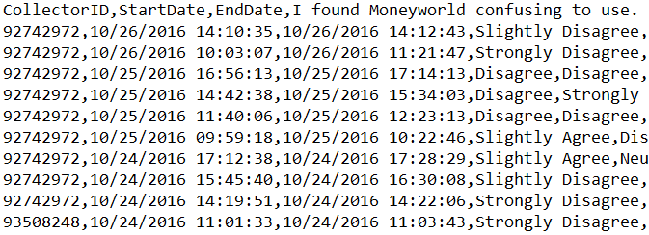
CSV format example

Slide 32
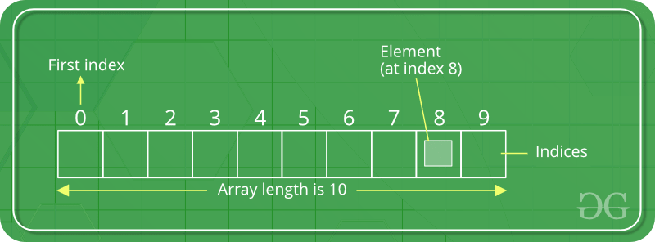
arrays
An array is a special variable, which can hold more than one value at a time.
Source: geeksforgeeks

Slide 33
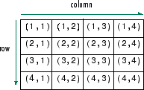
Multidimensional arrays
Multidimensional arrays are data arrays with more than two dimensions. Each element is defined by two subscripts, the row index and the column index.

Slide 34
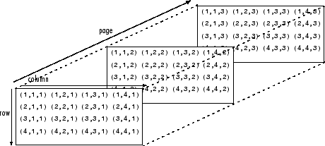
Multidimensional arrays
Multidimensional arrays are an extension of 2-D matrices and use additional subscripts for indexing. A 3-D array, for example, uses three subscripts. The first two are just like a matrix, but the third dimension represents pages or sheets of elements [2].

Slide 35
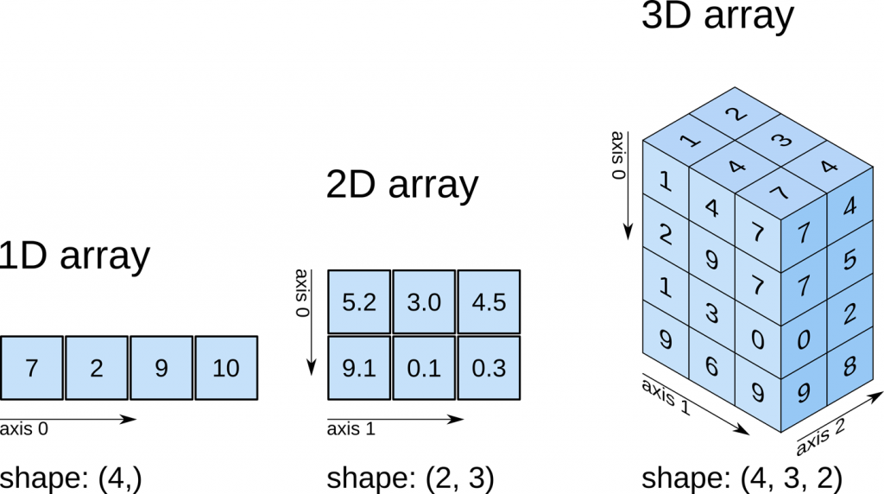
Source: predictivehacks

Slide 36
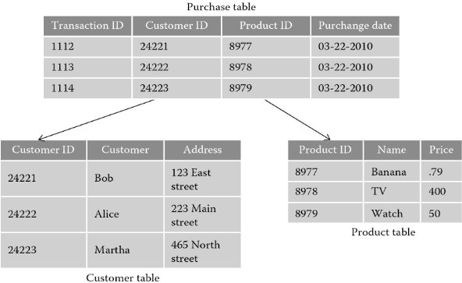
Relational tables
Multiple tables of data interrelated by key columns (what would be primary or foreign keys for a SQL user).
Image Source: Grace L. Samson Ph.D

Slide 37
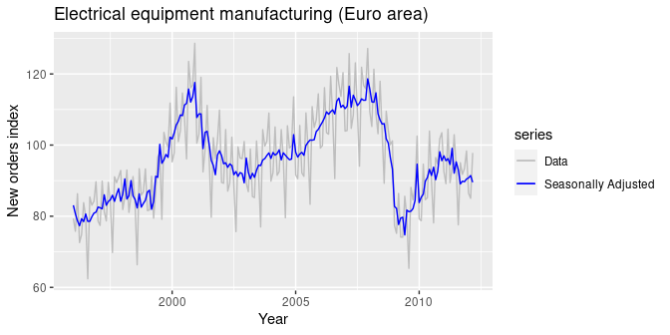
Time Series
Time series data is a collection of quantities that are assembled over even intervals in time and ordered chronologically. The time interval at which data is collection is generally referred to as the time series frequency [3].
Source: otexts.com

Slide 38
References
Rosett C.M., Hagerty A. (2021) Data Wrangling. In: Introducing HR Analytics with Machine Learning. Springer, Cham. https://doi.org/10.1007/978-3-030-67626-1_13
Stefanski, R., Sinha, V. and Poddar, A., 2022. Data Wrangling in 6 Steps: An Analyst's Guide For Creating Useful Data. [online] Learn | Hevo. Available at: https://hevodata.com/learn/data-wrangling/#s2
Tripathi, S., Muhr, D., Brunner, M., Jodlbauer, H., Dehmer, M. and Emmert-Streib, F., 2021. Ensuring the Robustness and Reliability of Data-Driven Knowledge Discovery Models in Production and Manufacturing. Frontiers in Artificial Intelligence, 4.

Slide 39
references
Python.org. 2022. What is Python? Executive Summary. [online] Available at: <https://www.python.org/doc/essays/blurb/>
McKinney, Wes. Python for data analysis: Data wrangling with Pandas, NumPy, and IPython. " O'Reilly Media, Inc.", 2012.
En.wikipedia.org. 2022. Anaconda (Python distribution) - Wikipedia. [online] Available at: https://en.wikipedia.org/wiki/Anaconda_(Python_distribution).

Slide 40
resources
https://docs.anaconda.com/anacondaorg/faq/#what-is-anaconda-inc
https://docs.anaconda.com/anacondaorg/glossary/#cloud-glossary-cloud

